Slide 1
MATLAB ASSIGNMENT 4
GROUP 16

Slide 2
GROUP 16 MEMBERS
NO. | STUDENT NAME | REG. NO. | COURSE | SEX | GITHUB LINK
1 | KABWERU ANDREW | BU/UG/2024/5057 | WAR | M | https://github.com/kabweruandrew39-alt/Andrew.git
2 | CHEMONGES MIKIRAR | BU/UP/2024/1005 | WAR | M | https://github.com/Chemonges-mikirar/Chemonges
3 | NAGASHA RITTA | BU/UG/2024/5055 | AMI | F | https://github.com/Nagasharitah/Nagasha-Ritta.git
4 | DIKITAL JOHN | BU/UP/2024/1125 | WAR | M | https://github.com/JOHNDIKITAL/johndikitalmatlab.git
5 | SANYU JOY | BU/UP/2024/5348 | MEB | F | https://github.com/joysanyu22-cell/SANYU-JOY.git
6 | OULE SADOCK | BU/UP/2024/0844 | AMI | M | https://github.com/oulesadock25/Oule-Sadock-.git
7 | WANGUSI DAVID | BU/UP/2024/5350 | MEB | M | https://github.com/wangusid22/WANGUSI-DAVID.git
8 | SEBATIKA COLLINE | BU/UP/2024/0845 | AMI | M | https://github.com/SebyatikaColline/Sebyatika-Colline.git
9 | ATYANG MILDRED | BU/UP/2024/1019 | WAR | F | https://github.com/mildredmoreen/ATYANG-MILDRED-.git
10 | KITUTU LEONARD | BU/UP/2024/1035 | WAR | M | https://github.com/leonardkitutu1-hue/leonard-kitutu.git

Slide 3
NUMBER ONE
Making codes based on recursive programming
Numerical approximation for finding the solutions to functions by newtons Raphson ad secant methods based on recursive programming
STEPS FOLLOWED
Step 1. drawing the flow chart
Step 2: suggestion on the equation to implement.
Step 3: defining the function, derivative and tolerance
Step 4: starting timer, calling the recursive NR function and stopping the timer
Step 5: displaying the results
Step 6: plotting function and roots
Step 7: writing recursive formulars for both functions
Step 8: saving and running the code
Results

Slide 4
WORKING PROCEDURE
Step 1
start
start
dy/dx=f(x,y), h, N, y(t)
dy/dx=f(x,y), h, N, y(t)
Y_{n+1 =} y_{n} +h*f(x_{n}, y_{n})
Y_{n+1} =y_{n} +6h(k₁ +2k₂+2k₃+k₄
Is x_{n+1} >= x_{end}
Is x_{n+1} >= x_{end}
y_{n} =y_{n+1,} x_{n}=x_{n+1}
Print y_{n}
Print y_{n}
stop
stop

Slide 5

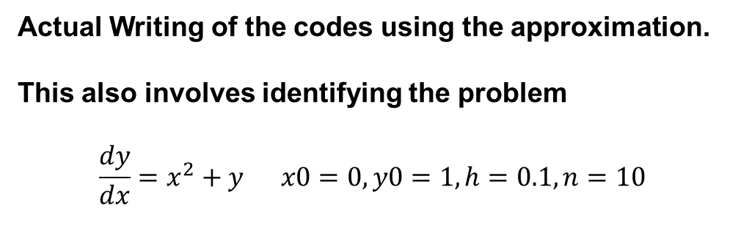
Actual Writing of the codes using the approximation.
This also involves identifying the problem
$$\frac{dy}{dx}=x^{2}+y x0=0, y0=1, h=0.1, n=10$$
Step 3, identifying the ode and initial conditions

Slide 6

Step 4:
Starting the clock, calling recursive functions and stopping the clock.
Step 5:
Displaying computation time, MATLAB has the fprintf function

Slide 7
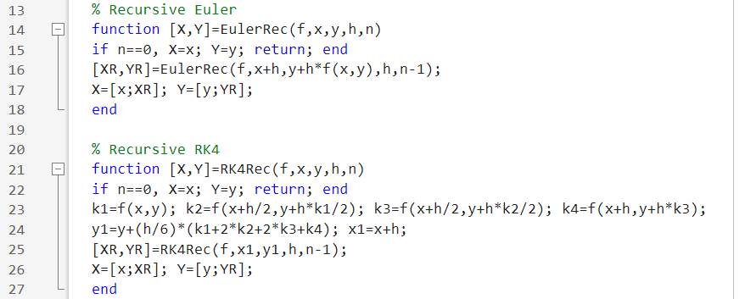
Step 6: visualisation (plotting)
Step 7: Recursive formulars for both function

Slide 8
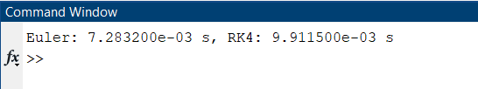
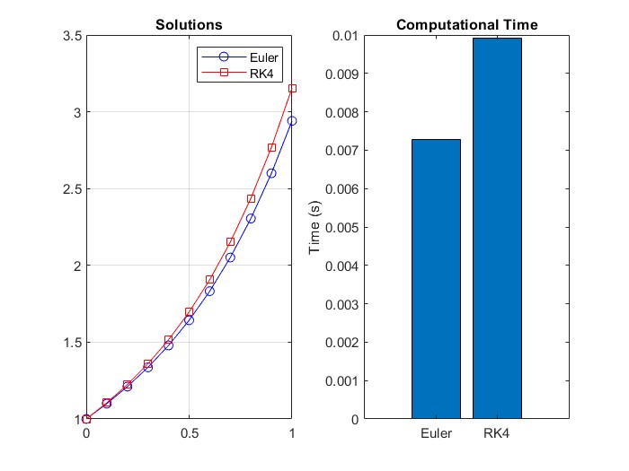
Step 8: saving and running the code
Visualization

Slide 9
QUESTION 2
Solving the Knapsack problem, Fibonacci and comparing computation times using recursive and dynamic programming
KNAPSACK PROBLEM
Step 1; analysing the problem to be worked on
Step 2: writing functions for Knapsack in both recursive and dynamic programming
FIBONACCI PROBLEM
Step 3: writing functions for Fibonacci in both recursive and dynamic programming
Step 4: testing and timing setup
Step 5: loops that run test and records times
Step 6: plotting both Knapsack and Fibonacci results

Slide 10
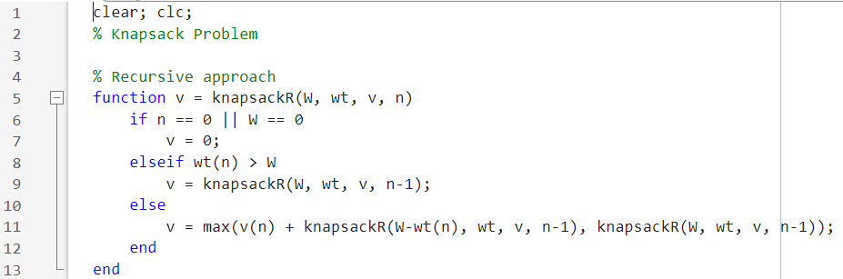
Step 1 explained
The codes were to compute the maximum value with capacity W, item weights wt, item values v, considering first n terms using both dynamic and recursive programming techniques
Recursive programming

Slide 11
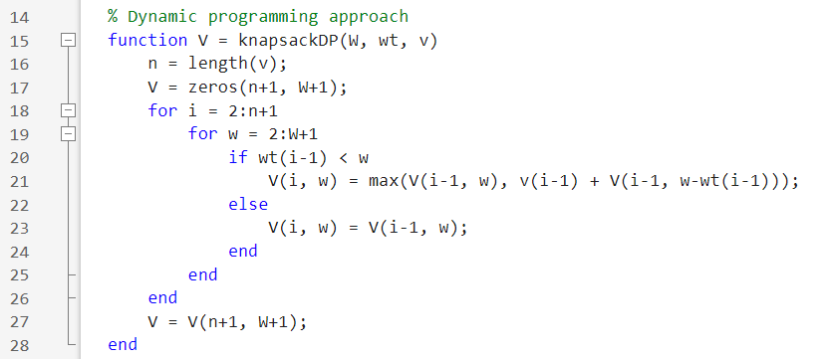
Dynamic programming
Step 3: writing functions for Fibonacci in both recursive and dynamic programming

Slide 12
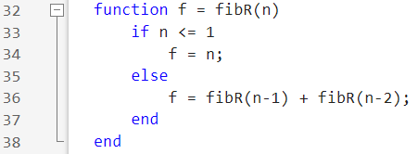
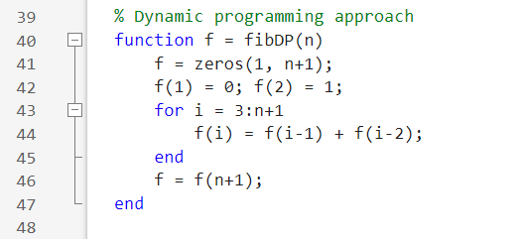
Recursive programming (for n=0, to n=1
Dynamic programming

Slide 13
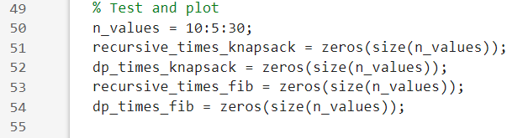
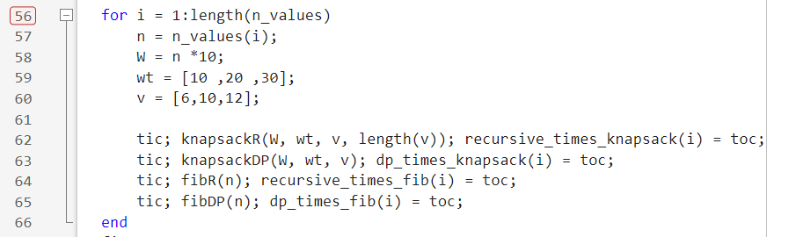
Step 4: testing and timing setup
Using n values from 10-30, pre allocated arrays to store execution times for each method problem.
Step 5: loops that run test and records times

Slide 14
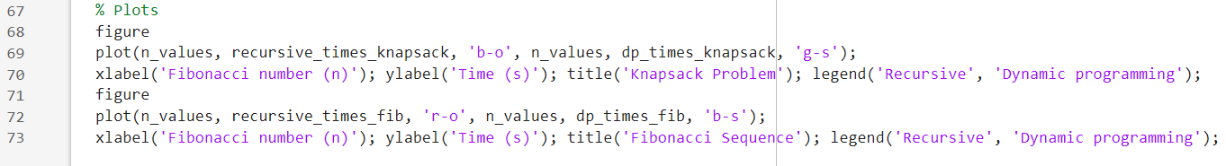
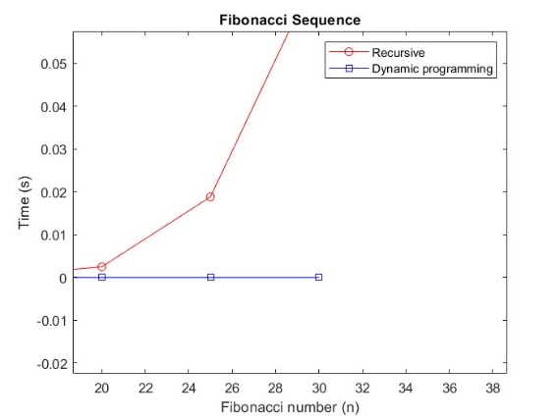
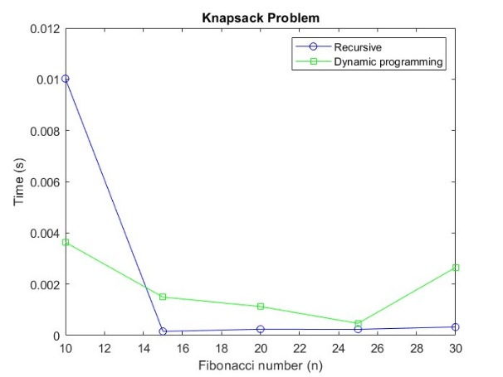
Step 6: plotting both Knapsack and Fibonacci results
Running the code

Slide 15
conclusion
Dynamic programming (DP) is far superior to naive recursion for problems with overlapping subproblems, like Fibonacci and Knapsack. Graphs show DP's time grows slowly, while naive recursion becomes too slow for larger inputs. The trade-off of using extra memory for massive speed gains is justified
THANK YOU

